Slide 1
Improved Recognition of Inpatient Hypercapnic Respiratory Failure
Brian Locke, MD
T32 Fellow
Division of Pulmonary, Critical Care, and Occupational Pulmonary Medicine
Department of Internal Medicine
University of Utah School of Medicine
This research was supported by the National Institutes of Health under Ruth L. Kirschstein National Research Service Award 5T32HL105321 from the NIH
and The American Thoracic Society through the Academic Sleep and Pulmonary Integrated Research/Clinical Fellowship (ASPIRE) Program

Slide 2
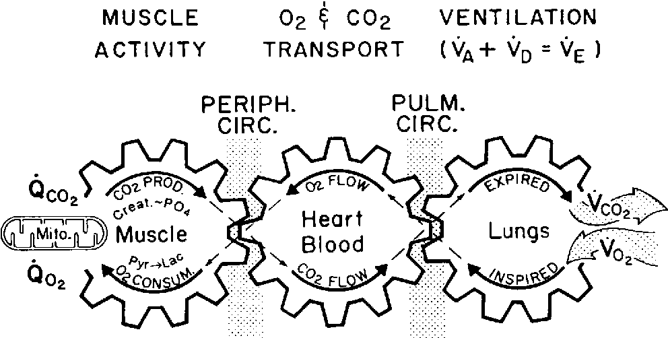
Hypercapnic Respiratory Failure
Build up here = CO2 in blood rises
Hypoxemic (Low O2) Respiratory Failure | Hypercapnic (High CO2) Respiratory Failure
Low arterial blood oxygen tension | High arterial blood carbon dioxide tension
(Relatively) Reliably Identified by Pulse Oximetry | No routine non-invasive testing
“What gets measured gets managed”
Patients with hypercapnia are identified unreliably and late in their illness
Notes:
There are two purposes to the respiratory system: get enough oxygen to the blood, and get enough CO2 out of the blood.
The role of the respiratory system is to keep the level of oxygen and carbon dioxide where they should be despite wide variations in metabolic rate.
We only pay attention to what we can measure

Slide 3
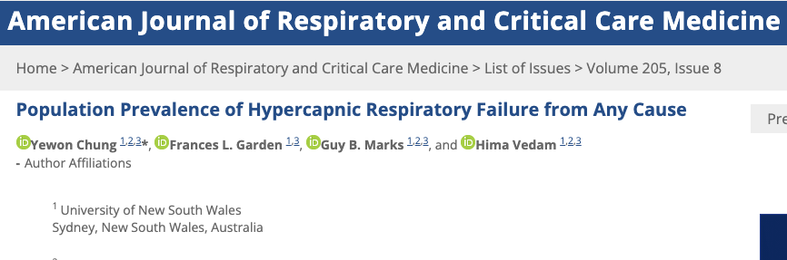
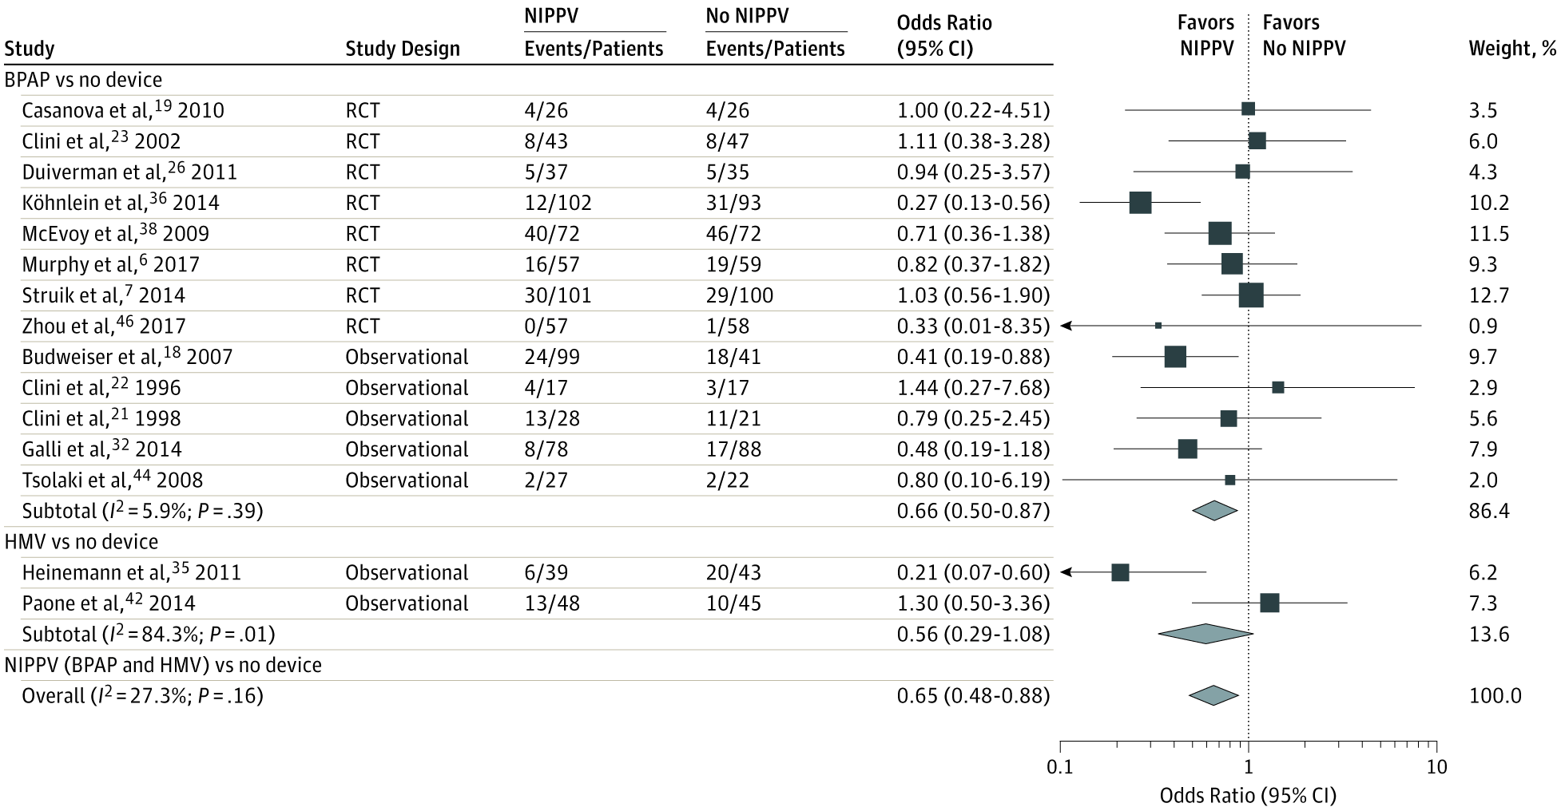

Hypercapnia is common, is probably becoming more common, and is treatable.
Common contributors to Hypercapnic Respiratory Failure:
Advanced Age
Opiate Use
Obesity
Advanced Lung Dz
Multimorbidity
E.g.: Home PAP improves mortality in ↑CO2-COPD
Weight loss
Medication Adjustment
Pulmonary Rehab
Population-standardized prevalence PaCO2 > 45 mmHg after excluding iatrogenic causes:
150* per 100,000 person/year
*Only inpatients, only those with blood gasses checked
Comparison: Decompensated Cirrhosis 94.9 (US, 2017) per 100,000 person year
Notes:
JAMA. 2020;323(5):455-465. doi:10.1001/jama.2019.22343
Cirrhosis: https://www.ncbi.nlm.nih.gov/pmc/articles/PMC7026710/
US: 33·2 (HCV) + 26·5 (EtOH) + 10·3 (NASH) + 24·9 (Other) = 94.9 per 100,000 prevalence in the US
Patients with decompensated cirrhosis have a worse prognosis than do those with compensated cirrhosis; the average survival without transplantation is approximately two years [13,14]
Comparison seems apt, as you could think of hypercapnic respiratoyr failure as decompensated ventilation

Slide 4

By the time patients are caught: ↑morbidity
Inpatient ICD code for Hypercapnic Respiratory Failure
23% 30d readmission rate
Same as CHF, more than MI
66% with recurrence
Lung Adenocarcinoma, for reference
Could we catch them earlier? Would it help?
Notes:
Lung Cancer survival rates https://seer.cancer.gov/statistics-network/explorer/application.html?site=47&data_type=4&graph_type=6&compareBy=sex&chk_sex_1=1&chk_sex_3=3&chk_sex_2=2&race=1&age_range=1&stage=101&advopt_precision=1&advopt_show_ci=on&hdn_view=0&advopt_show_apc=on&advopt_display=2#resultsRegion0
Roughly age normalized

Slide 5
OVERALL: There is an important burden of unrecognized hypercapnia among hospitalized patients. | OVERALL: There is a significant burden of unrecognized hypercapnia among hospitalized patients. 3 aims
 | Aim 1: Non-invasive Validation | Aim 2: Prevalence Estimate | Aim 3: Potential Impact
Hypothesis | Less invasive methods of blood CO2 assessment (TcCO2) Risk Stratification) can identify hypercapnia with sufficient accuracy to estimate prevalence. | There is a sizable prevalence of unrecognized hypercapnia among hospitalized patients. | Inpatients who were predicted, but not confirmed, to have hypercapnic respiratory failure are at comparable risk of readmission to those identified.
Barrier | TcCO2 and bicarbonate+ are perceived as problematic for individual patient use. | ABGs a selectively and unreliably obtained in clinical practice, and cannot be indiscriminately obtained for research | Prior work showing high readmission rates only assess patients who have been identified as hypercapnic.
Insight | Scatter, without bias, can allow accurate estimation of prevalence | Risk modeling allows for stratified sampling = better efficiency. | ABG PaCO2 is an imperfect reference standard
Approach | Obtain paired samples with ordered ABGs (inpatient). | Non-invasively sample (with TcCO2) patients by strata of predicted hypercapnia risk. | Among patients with an admission for hypercapnia that is identified, how many had preceding admissions likely to have hypercapnia?
Notes:
[ ] update this

Slide 6
Aim 1: To determine the local accuracy of non-invasive assessments of blood PaCO2
 | Total | No ABG Obtained | ABG Obtained
 | N=879,019 | N=675,620 | N=203,399
Ambulatory | 39% (343,699) | 50% (334,457) | 5% (9,242)
Emergency | 20% (175,792) | 22% (146,066) | 15% (29,726)
Inpatient | 41% (359,528) | 29% (195,097) | 81% (164,431)
Tool | Health Record-Based Modeling | Transcutaneous CO2
Purpose | Refine Estimation of Pre-test Odds of Hypercapnia | Allow non-invasive CO2 assessment (patients unlikely to consent for research ABGs)
Limitation | Approach only externally validated in outpatient OHS assessment | Prior 95% agreement +/- 6 mmHg insufficient for unstratified clinical use
Notes:
95% Agreement with PaCO2: +/- 6 mmHg, Bias +0.1 mmHg
Conway et al. Thorax 2019. SRMA 44 Studies (n=1786)

Slide 7
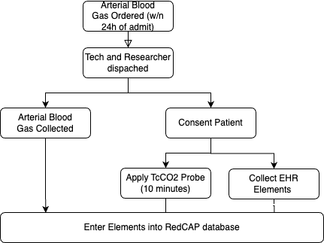
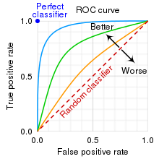
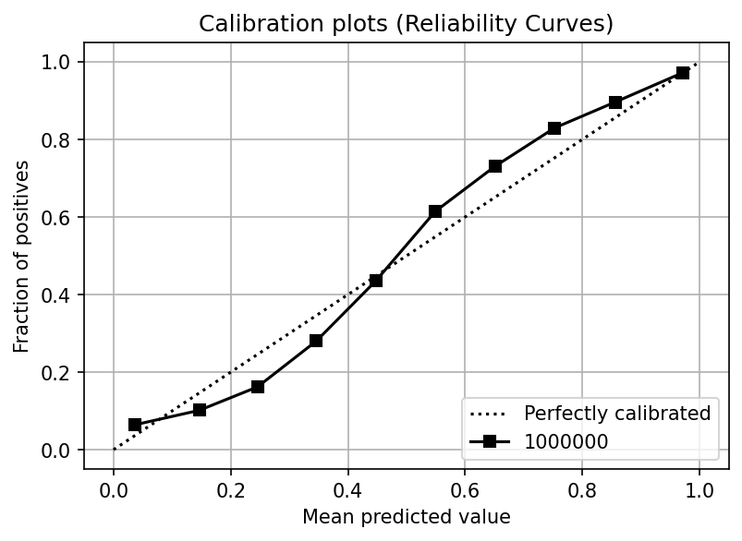
Aim 1: To determine the local accuracy of non-invasive assessments of blood PaCO2
N=~65 = power of 0.8 for TcCO2-PaCO2 LOA ~8mmHg
Expected Outcomes:
TcCO2 feasibility assessment
TcCO2 local limits of agreement
Predictive modeling external validation
Career development aim: prospective study design and execution

Slide 8
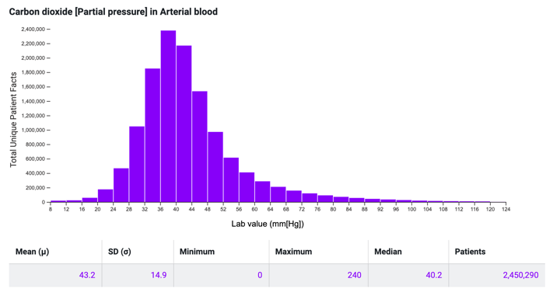
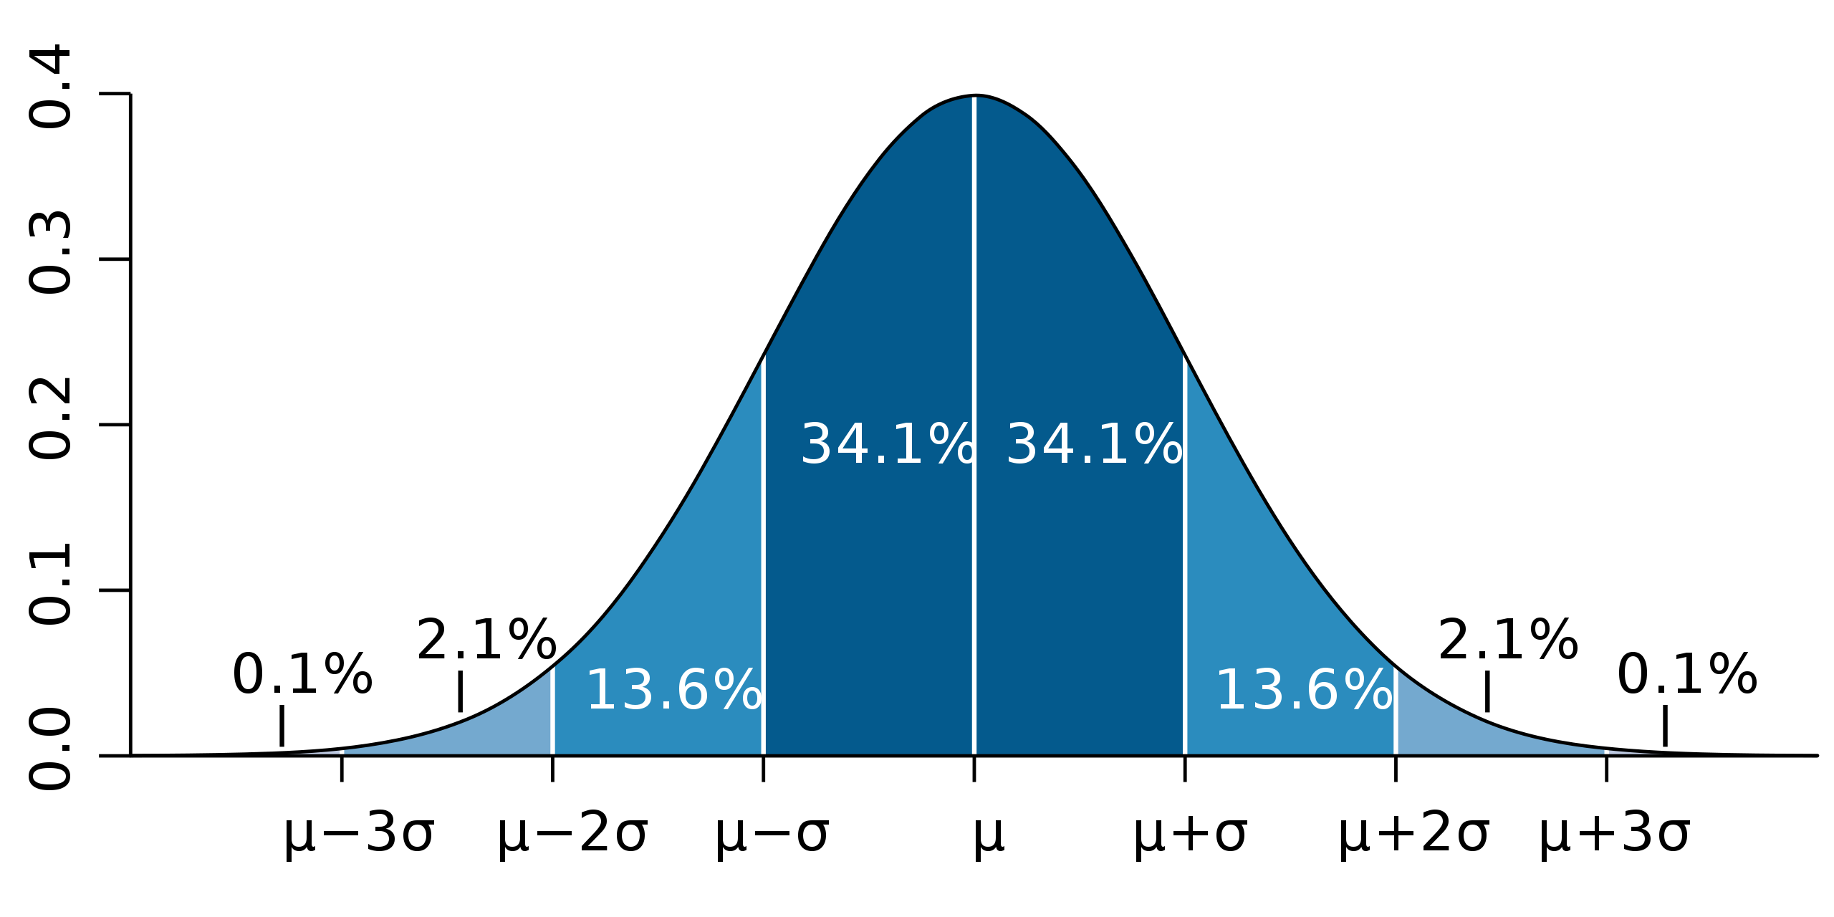
Aim 2: To estimate the prevalence of unrecognized hypercapnia in inpatients
Statistical Insights:
Accuracy needed for clinical care ≠ Required accuracy for prevalence estimate
Pre-test probability estimate allows stratified sampling → efficiency
…
49: Correct 93%, Wrong 7%: weight: 1.98%
48: Correct 88%, Wrong 12%: weight: 2.39%
47: Correct 80%, Wrong 20%: weight: 2.47%
46: Correct 69%, Wrong 31%: weight: 2.92%
45: Correct 57%, Wrong 43%: weight: 3.11%
SENSITIVITY
SPECIFICITY
44: Correct 57%, Wrong 43% 3.56%
43: Correct 69%, Wrong 31% weight 3.73
42: Correct 80%, Wrong 20% weight 4.16%
41: Correct 88%, Wrong 12% weight 4.25%
40: Correct 93%, Wrong 7% weight 4.58%
….
Expected test characteristics:
sensitivity = 89%
specificity = 92%
if
agreement ~6 mmHg
same distribution of CO2

Slide 9
Aim 2: To estimate the prevalence of unrecognized hypercapnia in inpatients
Design:
Within 24 hours of admit
Stratified sampling by decile of the predicted likelihood of hypercapnia
Overall prevalence estimate = weighted [by overall hospital] average of decile prevalences.
Apply TcCO2
Sample Size Calculation:
Complex: Upper bound = unstratified: n=200 would give 5% 95CI width at expected prevalence of 2.5%
Outcomes:
Estimated in-hospital prevalence
% recognized(?) – should information be shared with teams? (or, vs historical control)
How will this fail?
Several pieces of data will update power calc
(distribution of predicted hypercapnia deciles, bias/agreement of TcCO2)
Can I access EHR data fast enough?
Hawthorne effect?
What if TcCO2 isn’t good enough? (VBG?)
Elevation adjustment? Due to hypoxemia, do they get identified earlier?
Nowbar et al. 2004: All w/ BMI ≥35 kg/m² admitted to inpatient medicine service at the Denver VA. Everyone (n=277) gets an ABG. 31% had hypercapnia. Only 1/3 of those had therapy started (teams were told)

Slide 10
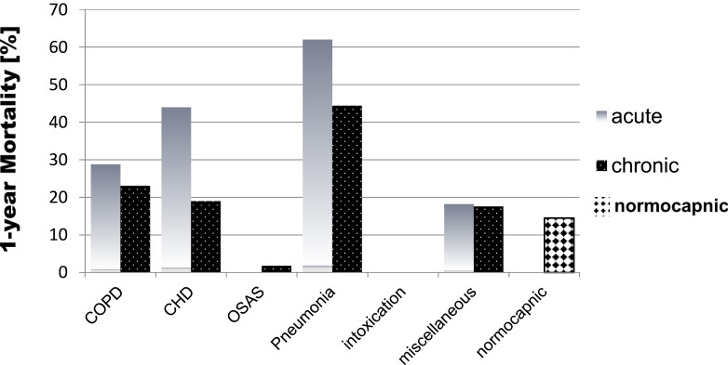
Aim 3: To estimate the potential impact of early & reliable identification
More aggressive case identification could lead to underwhelming improvements in important outcomes if:
Clinicians already identify the important cases
Or, if earlier identification doesn’t actually facilitate helpful treatment
Perhaps, nothing bad would have happened in the period between identifications
Or, nothing could be done to change that trajectory
Rigor of the supporting research:
Marik et al. 2013: patient diagnosed with OHS are repeatedly admitted and missed diagnosed prior to their ultimate recognition
*Single center with non-representative enrollment (only obese patients)
Meservey et al 2020. and Vonderbank et al 2021: readmission rates are high after diagnosis (~1/3 of patients) - likely because the pipeline from identification to treatment is very unreliable.
*This only studies patients who are identified as hypercapnic
Cavalot et al 2022: across etiologies (enrolled in an emergency department), patients with hypercapnia (by ABG) have worse outcomes than patients without
*Not matched for other prognostic indicators
Notes:
e.g. we don’t just want to focus on identifying more patients who would have a blood gas CO2 over 45 mmHg if it were checked… we want to identify the patients who have and are going to continue to have clinically important respiratory failure and, ideally, those who will benefit from known therapies.

Slide 11
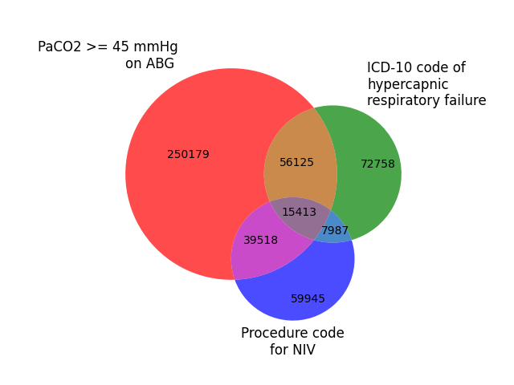
Aim 3: To estimate the potential impact of early & reliable identification
Hypothesis: Patients predicted to have had hypercapnia that was not recognized have a similar or excess risk of subsequent readmission as those identified (by blood gas and/or ICD code)
Study Design:
Retrospective EHR-based review
Dataset: Longitudinal, ideal self-contained system
Exposures of interest:
Hypercapnic Respiratory Failure by ICD code
Hypercapnic Respiratory Failure by ABG (or by VBG) & not ICD code
Predicted Risk of Hypercapnic Respiratory Failure by commonly obtained data-elements
Effect modifier: PAP/NIV therapy
Outcome: Hazard of death or rehospitalization with hypercapnia
Model predicted to have hypercapnia
Comparison in consequences
Those who likely had hypercapnia, but were not sampled

Slide 12
Additional Design Thoughts:
Data requirements: need to be able to accurately obtain relevant data elements for prediction model (if they were obtained by providers)
Musts: Demographics, labs (BMP), ABG & VBG data*, Diagnostic Codes, Admissions, Deaths
Ideal? PAP and oxygen prescriptions
Possible Designs | Possible Designs
Single arm | Case-Control | Matched Cohort
Inclusion: 1st identified hypercapnic respiratory failure admission | Case: 1st identified Hypercap-RF Control: matched hypox RF? | Exposure: %Predicted likelihood of hypercapnia [including 100% when confirmed]
# and rate of preceding likely-hypercap admissions | OR of a prior “likely to have hypercapnia” encounter | HR of readmission or death, modeled with restricted cubic spline [or categories]

Slide 13
Additional Design Thoughts:
Threats to validity:
Would be difficult to show it’s the predicted hypercapnia risk that raises risk, per-se (rather than things associated with it… negative control outcomes?)
Risk of readmission may be lower when hypercapnia is identified and proper treatment is instituted (which will be hard to determine from either ICD codes or procedure codes, I think)
Risk among patients with hypercapnia is not binary [ie risk PaCO2=90 >>> 50]

Slide 14
What is expected to come from this research?
Validation of a method of stratification that can be used to:
Facilitate the identification of patients with high CO2 → improved patient care
Identify patients with hypercapnia (± a verification method) for study inclusion → more representative cohorts of patients.
Enable future studies assessing:
Overall burden of disease from hypercapnic respiratory failure
Effect of exposures (medications, environmental, policy) on risk of hypercapnia
Test the effect of treatment interventions on broader types of high-risk patients.
Career-development:
Development of models (statistical, ML, etc.) exploding in healthcare
a dearth of validated uses → investigators with experience in prospective model application and validation needed

